Slide 1
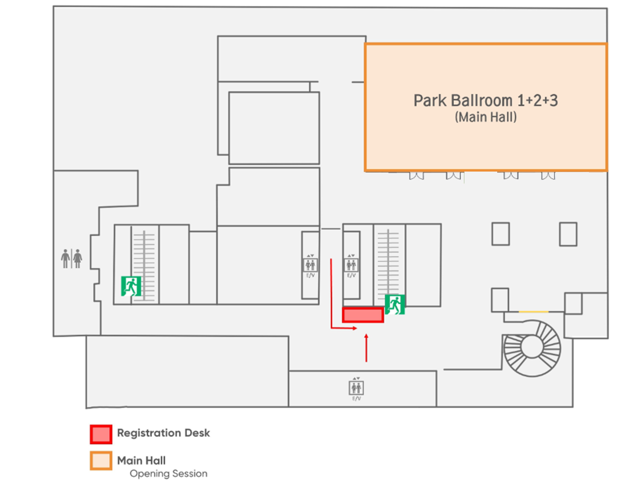
The 9th IFCF Floor Map
Conrad Seoul
5F
[Registration Desk]
- Before heading to the Main Hall, please make a quick stop at the registration desk to pick up your nametag.
[Main Hall] Park Ballroom
- Opening Session
- Networking Event
5F
6F
[Thematic Sessions]
- Session 1 : Studio 1-2
- Session 2 : Studio 3

